Slide 1


Primitive Data Types

Slide 2


https://fhstp.github.io/comixplain
This comic was created in the course of the research project Comixplain, funded by St. Pölten UAS in the course of the Innovation Call 2022.
Project Team:
Victor-Adriel De-Jesus-Oliveira
Hsiang-Yun Wu
Christina Stoiber
Magdalena Boucher
Alena Ertl
Contact:
victor.oliveira@fhstp.ac.at
Illustrations: Magdalena Boucher & Alena Ertl

Slide 3
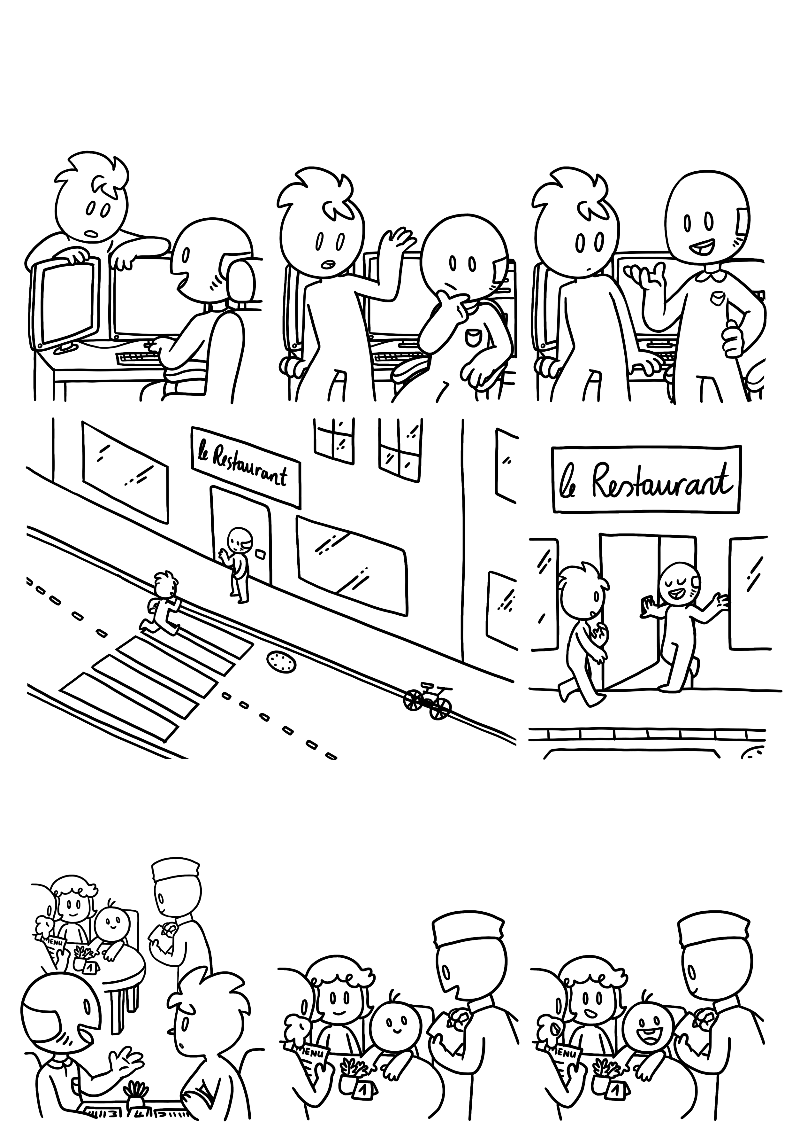
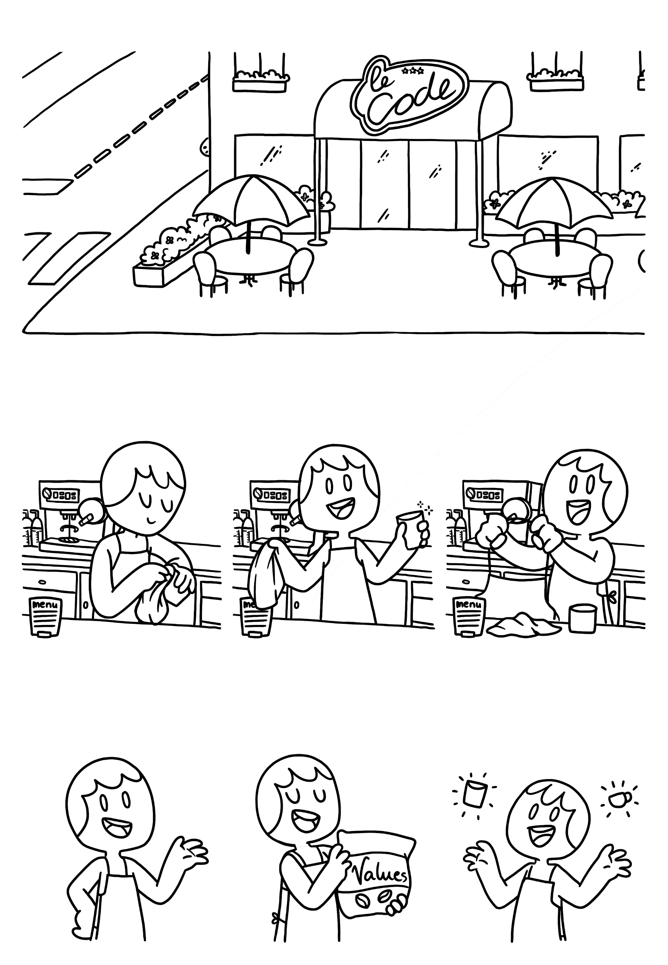

Oh, you must be the new hire our manager was talking about!
You know what? Let‘s talk about this over lunch at the restaurant down the road!
Primitive Data Types
What do you mean you‘re not?
Of course you are! Here‘s your apron. Come with me and I will show you the ropes quickly.
Your job is to execute orders from the program, uh, I mean the kitchen…
And to put values
…uhm coffee…
Into containers!

Slide 4
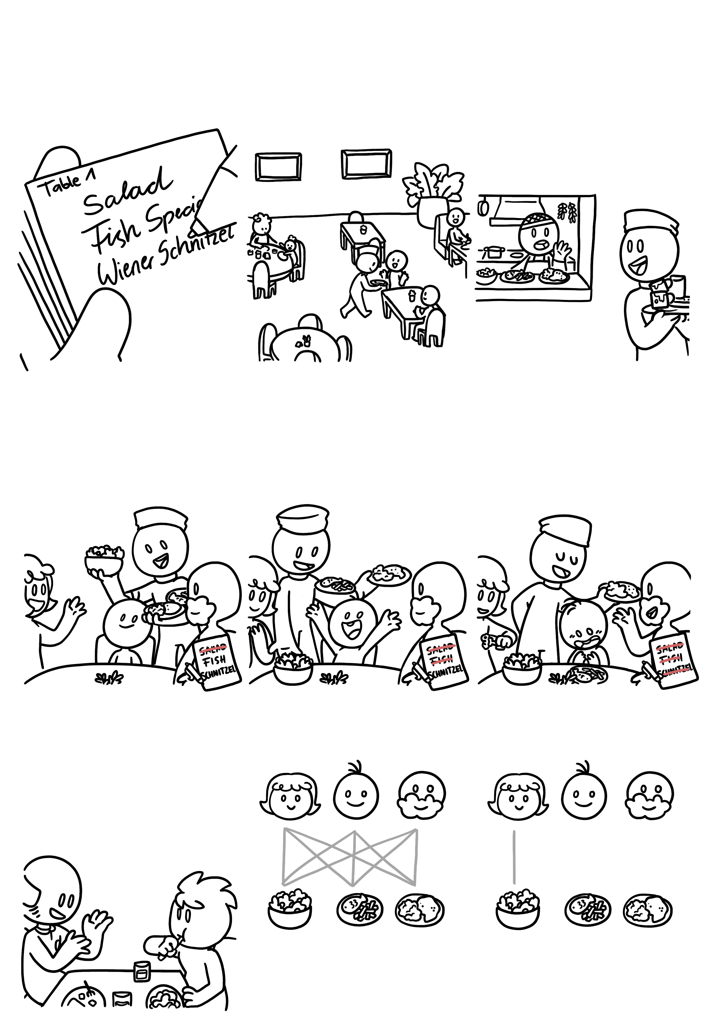
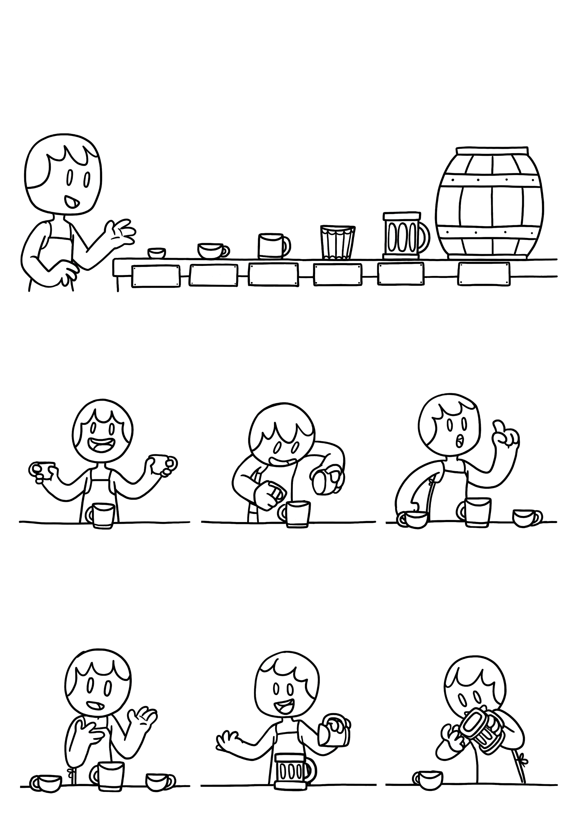



Here are our different containers that we use. Don‘t worry about the exact number ranges.
Primitive Data Types
+ - 4,9E - 324
+ - 1,7E + 308
+ - 1,4E - 45
+ - 3,4E + 38
-32,768
+ 32 767
- 2 x 10^9
+ 2 x 10^9
- 9 x 10^18
+ 9 x 10^18
-128
+127
BYTE
SHORT
INT
LONG
FLOAT
DOUBLE
Sometimes you‘ll have to pour the contents of glasses into others.
Just be mindful of one thing.
Easy isn‘t it?
20
20
20 + 20
=
40
20
40
20
Int
You‘re actually not emptying the original glass but copying the content into a new cup.
Also, you can always copy the content of a smaller glass into a larger one.
But what happens when we pour a float into a short?
20
40
20

Slide 5
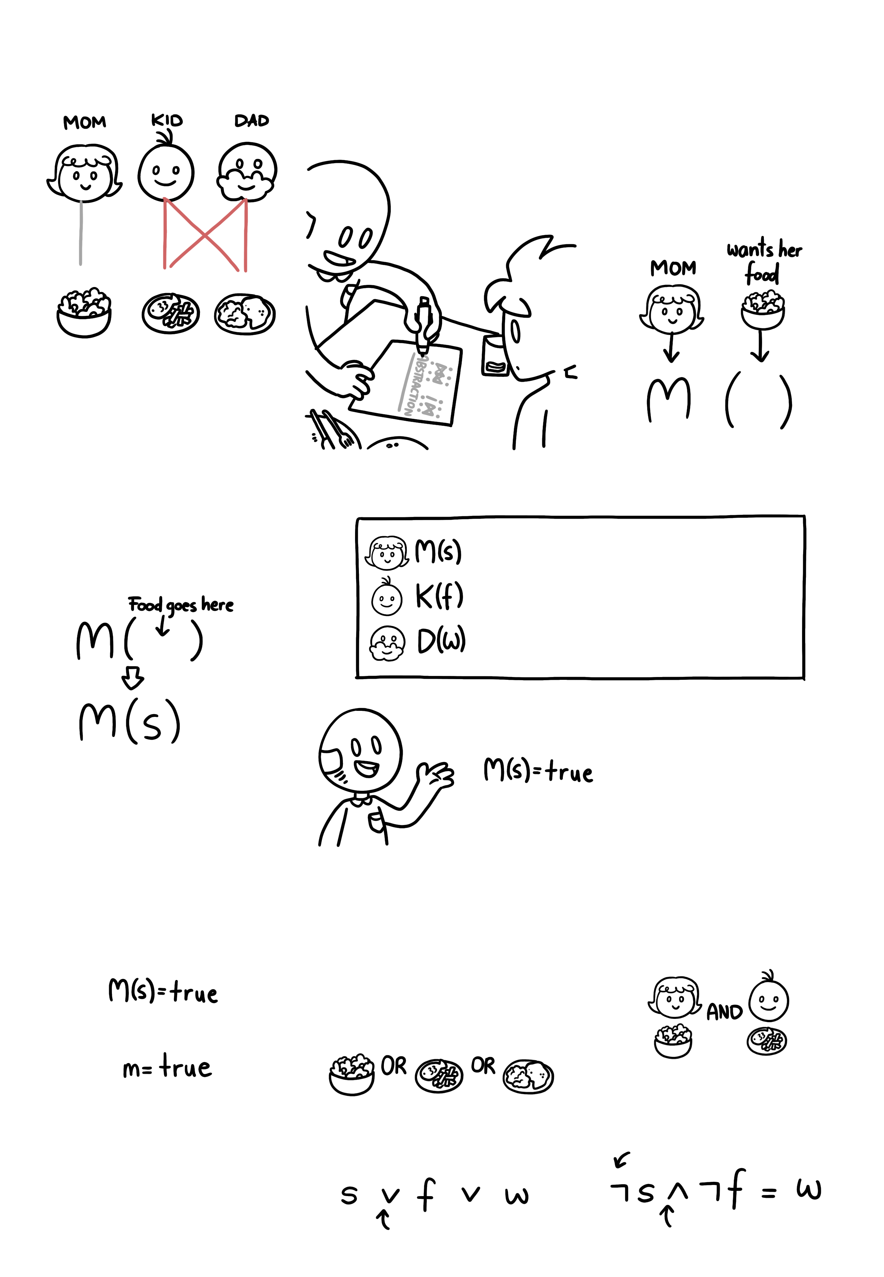
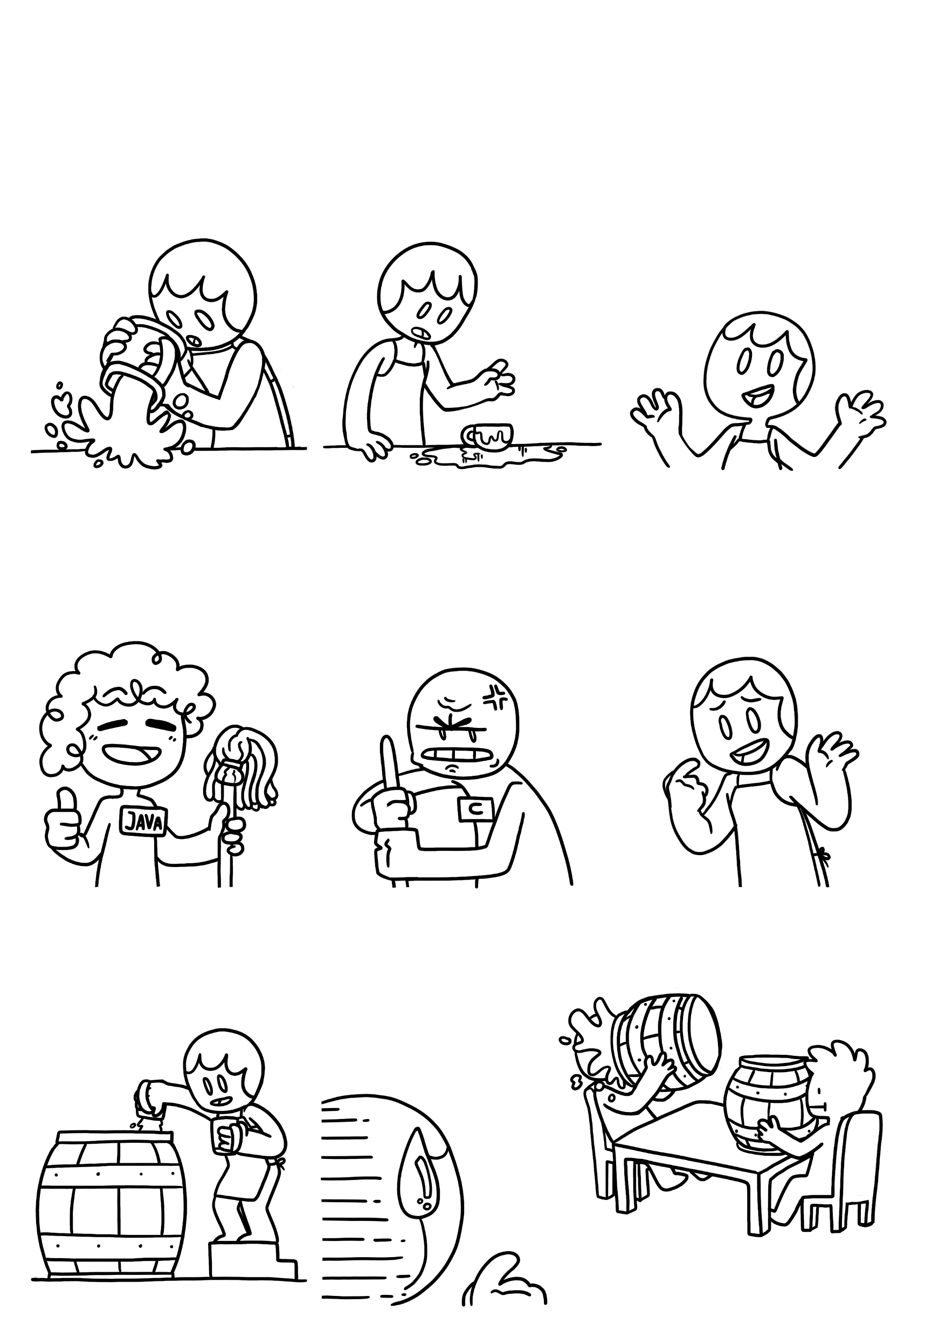

Only a part of it will fit.
Primitive Data Types
And the rest will leave a huge mess on the counter.
And whether that’s bad depends on the manager you’re working with,
See this person here? She won’t be bothered much and will clean it up for you.
But NEVER do this under his watch. He will throw a fit!
So depending on what you are working on, try to avoid it.
You may ask yourself why don’t we just put everything into doubles.
…but there wouldn’t be much space left on the tables…
So please choose appropriate sizes.

Slide 6
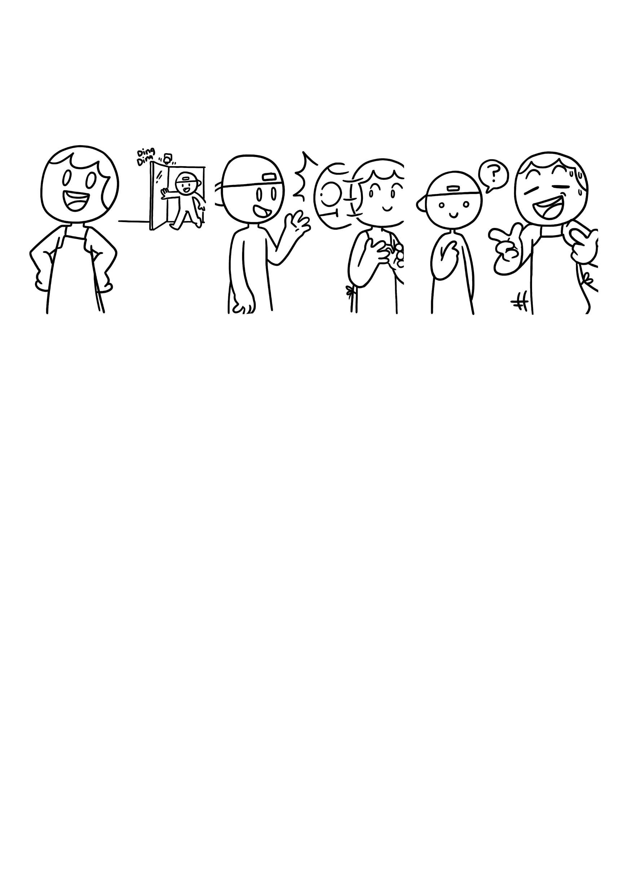


This is all you need to know to get started, so enjoy your first da-
Primitive Data Types
I’m the new hire and my first shift should start today. I was told to come to you.
You know what? I’m quite busy, how about you explain them what to do!
Hello!
How would you explain the concept of primitive data types to the new employee? Use this space to make notes and drawings.

Slide 7



Primitive Data Types
Javascript
Explain different types on different languages
Java
The ones used are the numerical ones from java
Python
Additional types
8

Slide 8
Primitive Data Types © 2024 by Comixplain Team: Victor-Adriel De-Jesus-Oliveira, Hsiang-Yun Wu, Christina Stoiber, Magdalena Boucher, and Alena Ertl, with illustrations by Magdalena Boucher and Alena Ertl, all employed by Sankt Pölten University of Applied Sciences is licensed under CC BY-SA 4.0. To view a copy of this license, visit http://creativecommons.org/licenses/by-sa/4.0/
Sources:
Knudsen, J., & Niemeyer, P. (2005). Learning Java. O'Reilly.
Mughal, K. A., & Rasmussen, R. W. (2003). A programmer's guide to Java certification: a comprehensive primer. Addison-Wesley Professional.

